Slide 1
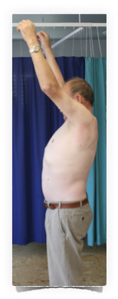
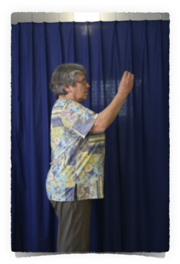
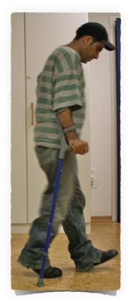
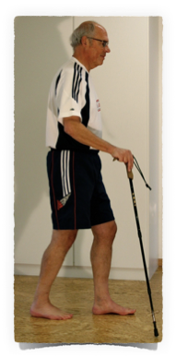
Clinical Reasoning
Ulla Bertinchamp, IPNFA® Advanced Instructor
Frits Westerholt, IPNFA® Senior Instructor

Slide 2
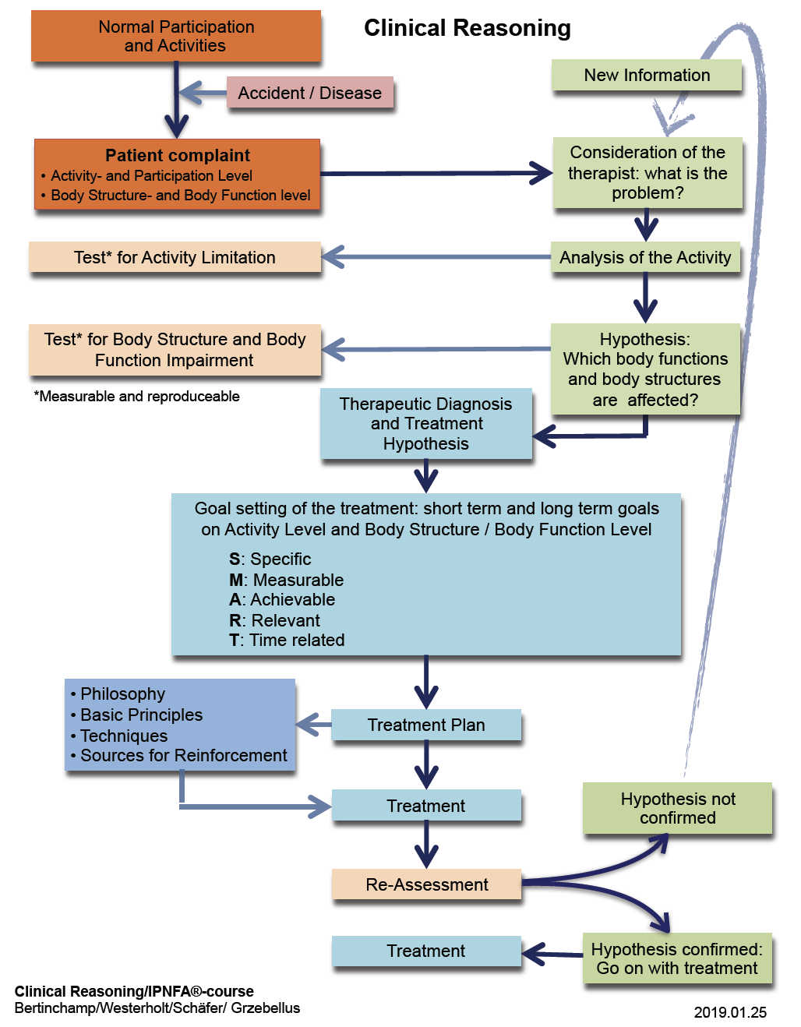

Slide 3
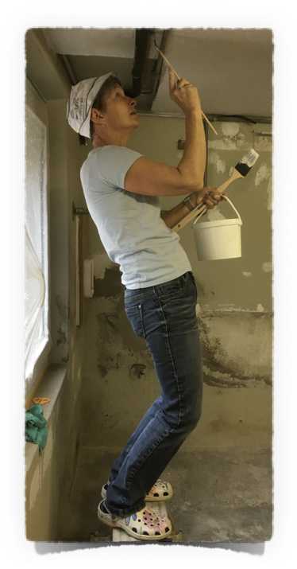
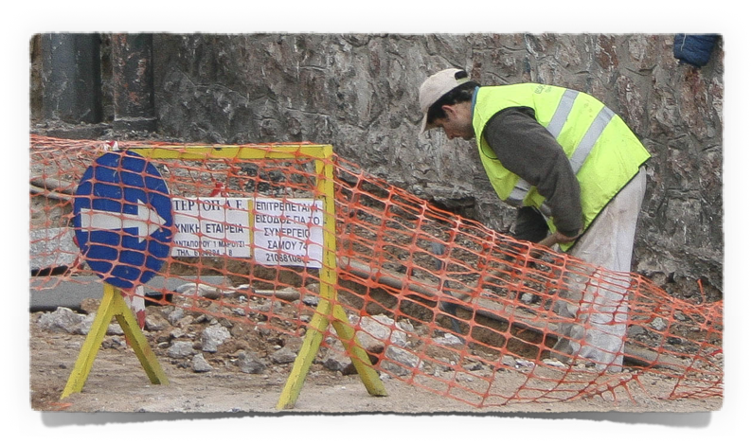
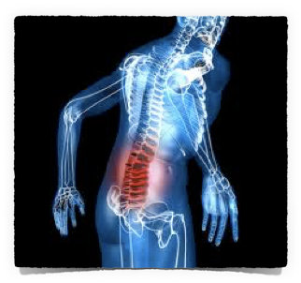
Clinical Reasoning
Normal Participation
and Activities
Accident / Disease
Patient complaint
Activity- and Participation Level
Body Structure- and Function level
Consideration of the therapist: what is the problem?

Slide 4
Clinical Reasoning
Consideration of the therapist: what is the problem?
Measurable / Reproductable
Test for Activity Limitation
Analyse Activity
Test for
Body Structure and Function Impairment
Hypothesis:
Which Body Structures and Functions are affected?
Therapeutic Diagnosis and Treatment Hypothesis

Slide 5
Clinical Reasoning
Therapeutic Diagnosis and Treatment Hypothesis
Goal setting of the treatment: short term and long term goals
S: Spezific
M: Measurable
A: Achievable
R: Relevant
T: Time related
Philosophy
Basic Principles
Techniques
Sources for Reinforcement
PNF
Treatment Plan
Treatment

Slide 6
Clinical Reasoning
Consideration of the therapist: what is the problem?
New Analysis
New Hypothesis
Treatment
Hypothese not confirmed
Re-Assessment
Hypothese confirmed:
Go on with treatment

